Slide 1

MCA Major Project Mid Term Evaluation
Resume Builder
Under the guidance of
Dr. Monika Jyotiyana
Department of Computer Applications
Faculty of Science, Technology and Architecture
Manipal University Jaipur
By
Divyanshu Singhal
23FS20MCA00072
2023-25

Slide 2
Outline
Introduction
Motivation
Process Model
Software Requirement Specification (SRS)
Data Flow Diagram (DFD)
Conclusion
Future Scope

Slide 3
INTRODUCTION
In today’s competitive job market, a well-crafted resume plays a crucial role in showcasing a candidate's skills and experiences. However, building a professional resume can be a time-consuming and complex task. To address this challenge, I have developed a Resume Builder application as part of my major project during my internship.
This platform is designed as a Software-as-a-Service (SaaS) solution for colleges and educational institutions, allowing them to provide a branded, white-labeled resume-building experience for their students

Slide 4
MOTIVATION
The motivation behind this project stems from the need to streamline resume creation at an institutional level and provide a scalable, enterprise-grade solution.
Helping students transition to the job market: Many students struggle with resume formatting and structuring. By providing a college-branded platform, institutions can guide students effectively.
White-labeling for institutions: Colleges can offer this tool as their own service, improving student placement support without developing software from scratch.
Scalable SaaS model: The project is built to support multiple institutions, offering customization and easy deployment.
Learning and innovation: This project has allowed me to explore enterprise-level SaaS development, integrating Next.js, Node.js, MongoDB, authentication systems, and scalable architecture.

Slide 5
PROCESS MODEL
Agile DEVELOPMENT
Why Agile?
Iterative Progress – Deliver incremental improvements with each sprint. Scalability – Adaptable for SaaS with continuous feature updates. User-Centric – Regular feedback loops ensure alignment with client needs.
Phases:
Phase 1: Core Resume Builder
Phase 2: AI-Powered Enhancements
Phase 3: Cover Letter & Job-Specific Customization
Phase 4: Custom Branding & White-Labeling
Phase 5: Continuous Feedback & Refinements

Slide 6
SOFTWARE REQUIREMENT SPECIFICATION
User Roles & Features:
Functional Requirements:
Students: Create, edit, and download resumes.
College Admins: Manage student accounts, track usage.
Super Admin: Manage multiple institutions, set up subscription plans.
Non-Functional Requirements
Scalability – Handles multiple colleges & users Security – Encrypted data, JWT authentication Performance – Fast resume generation Availability – Cloud hosting with 99.9% uptime

Slide 7
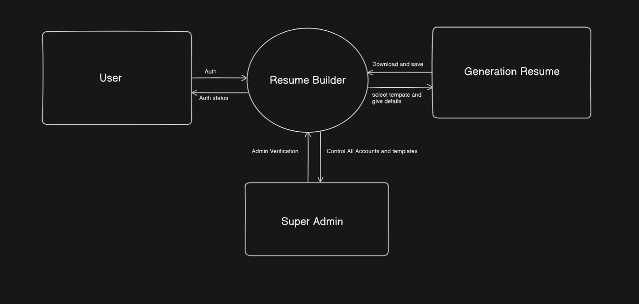
DATA FLOW DIAGRAM

Slide 8
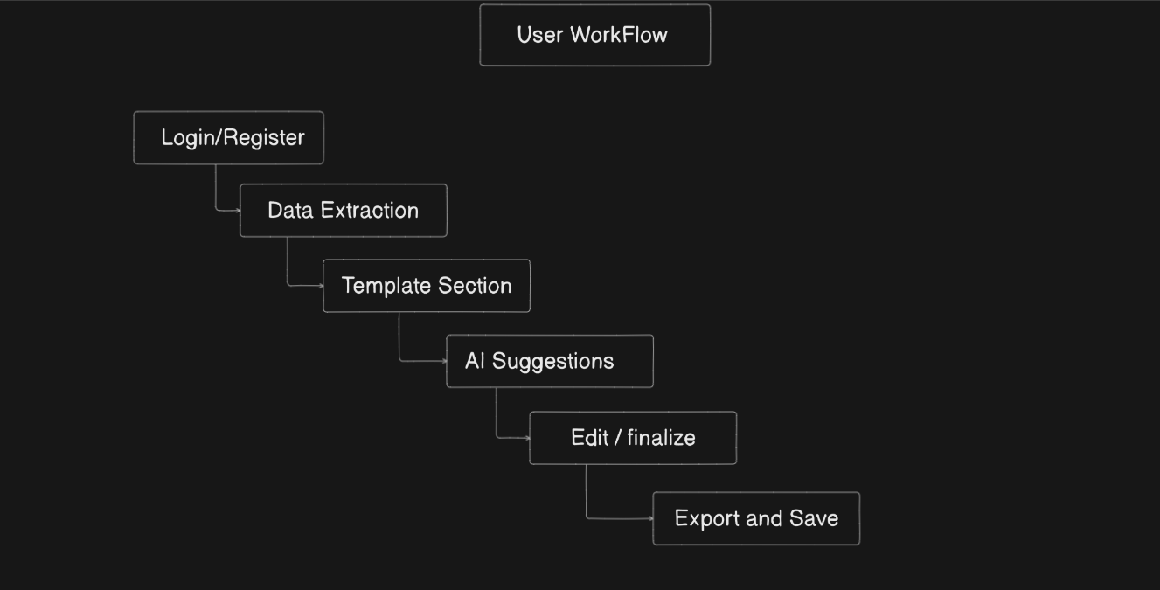
WORK FLOW DIAGRAM

Slide 9
CONCLUSION
The Resume Builder SaaS platform offers a white-labeled, scalable solution for colleges, enabling students to create professional resumes with ease.
By integrating Next.js and Node.js, the platform ensures:
Seamless performance with fast resume generation.
Secure authentication using OAuth and JWT.
Scalable architecture to support multiple institutions.
With AI-powered enhancements and LinkedIn integration planned for the future, the platform aims to become a comprehensive tool for student placements, helping colleges boost employability outcomes.

Slide 10
FUTURE SCOPE
AI-Powered Resume Suggestions
LinkedIn Integration
Resume Analytics for Colleges
Multi-Language Support

